Slide 1

High-Volume Real-Time Data Visualization
Patrick Cao
Software Engineering Intern
August 25, 2016
Notes:
position

Slide 2
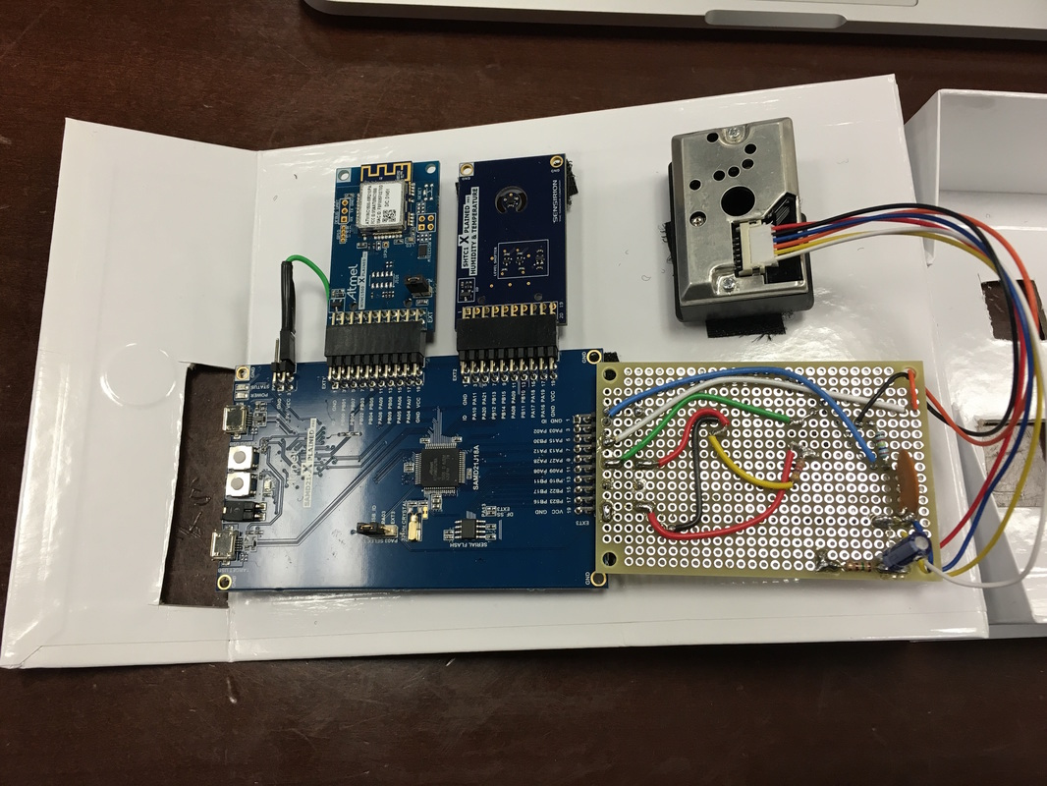

Introduction

Slide 3



Overview
Introduction to Nimbus
Project Objective
Implementation of Cubism Chart
Architecture and flowchart
Demo and Usability

Slide 4


Introduction to Nimbus
Nimbus: a cloud-based solution for real-time production surveillance and optimization
Data Visualization
Voltage
Amps
Pressure
Temp

Slide 5
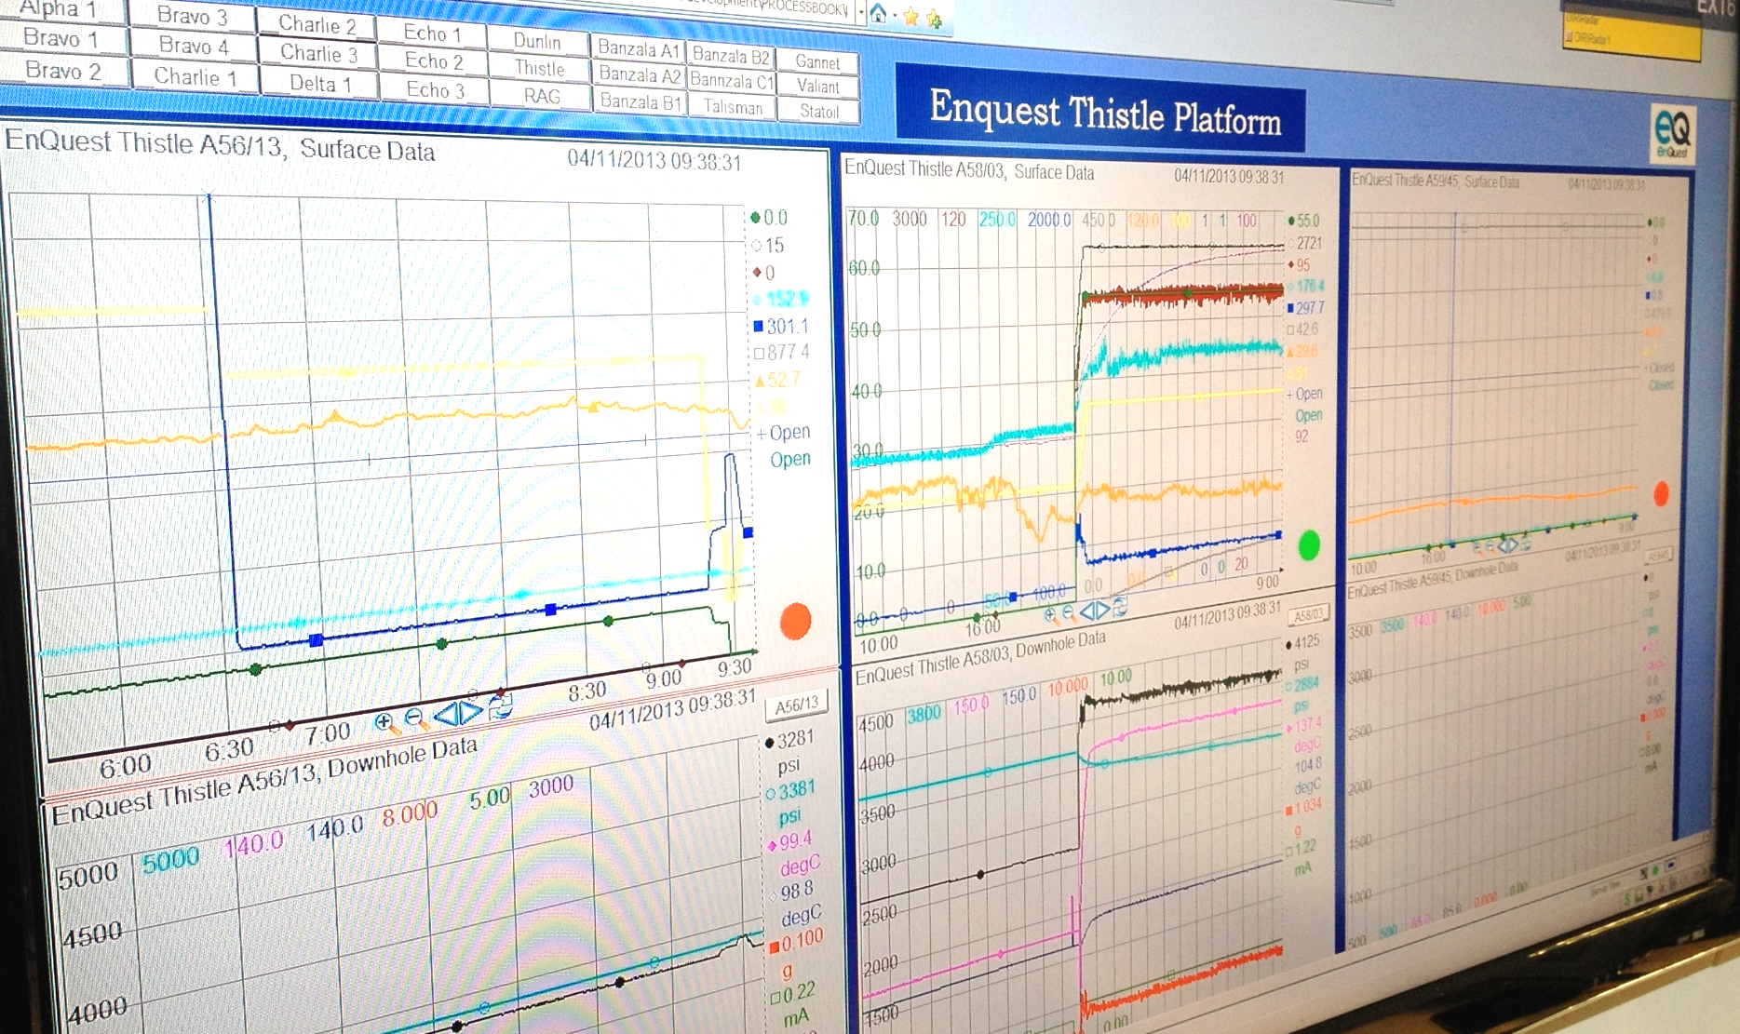
PI Process Book
Notes:
Current Desktop Application:
PI Process Book
Software (non-SLB) used by Artificial Lift Surveillance Center Engineers in Inveruie, Scotland
Disadvantage: Difficult to read, leading to a longer response time
Stacking makes middle lines hard to read

Slide 6
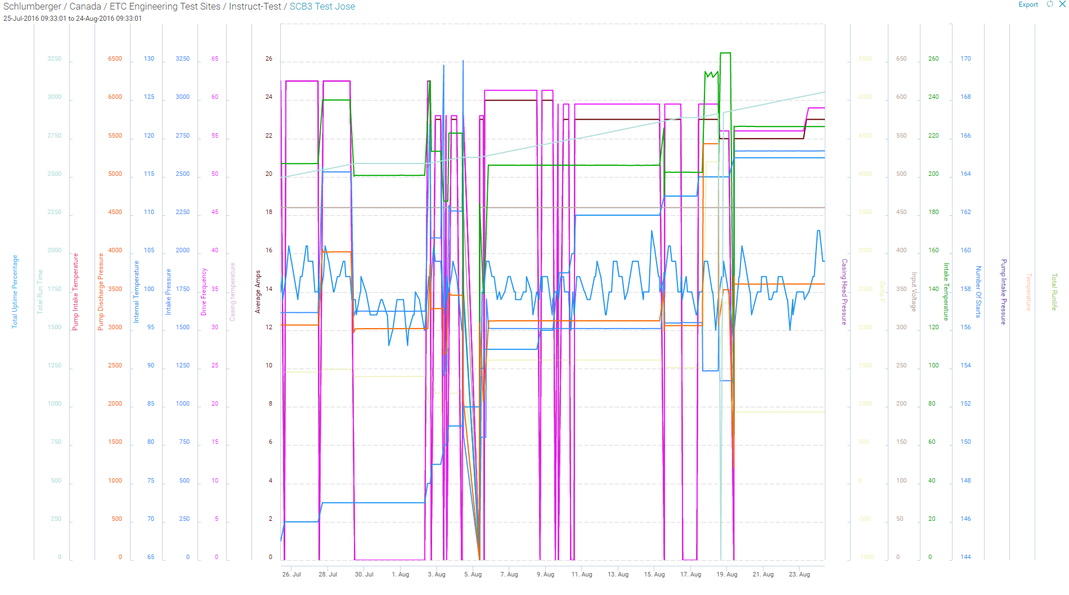
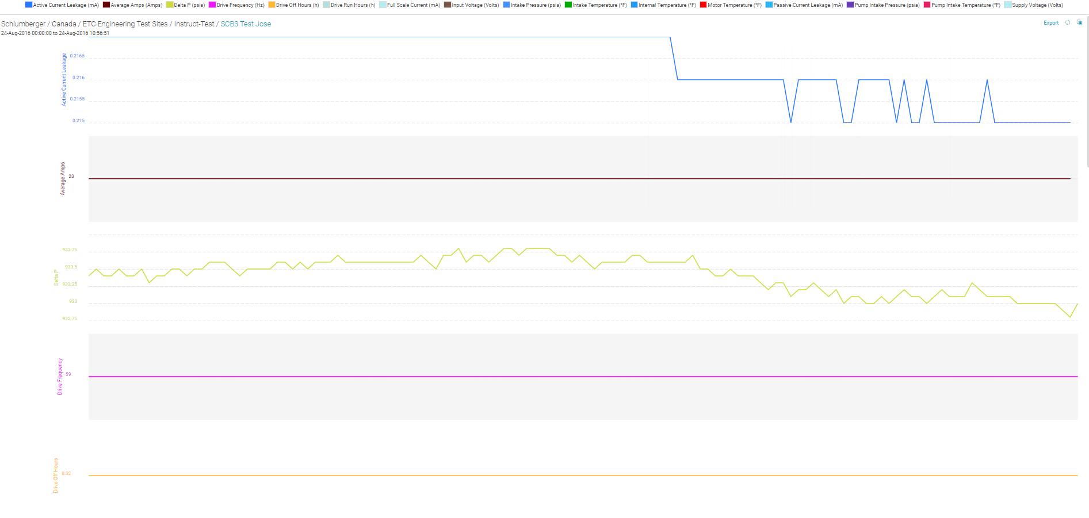
LiftWatcher

Slide 7
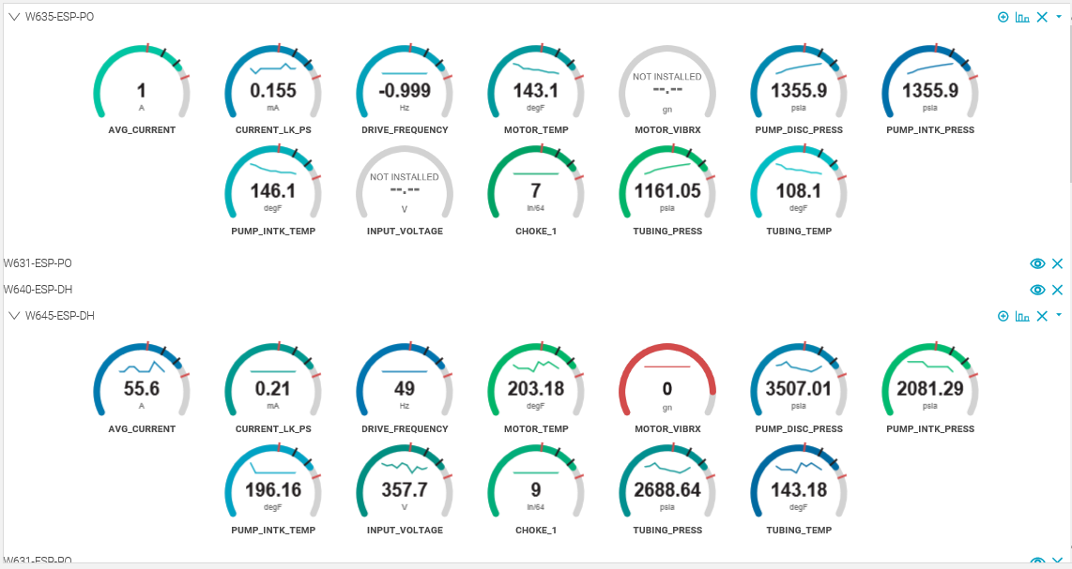
RTPDD
Notes:
Previous Product: Real-Time Production Data Delivery (RTPDD) Surveillance Dashboard
Feedback from
surveillance engineers:
too much wasted space

Slide 8
Objective
User
Surveillance Engineers
Visualization Requirements
Easy to use
Easy to read
Lots of data
Use Case
Improve anomaly detection
Improve crisis diagnosis
Notes:
Business:
System design
Market analysis
Task management
Clifford Stoll
Visualization is not a substitute for log analysis or automated alerts; instead, it utilizes human perception to process lots of data quickly and approxi­mately. Detecting trends and anomalies at-a-glance is fast and flexible, but it also requires you to look!

Slide 9
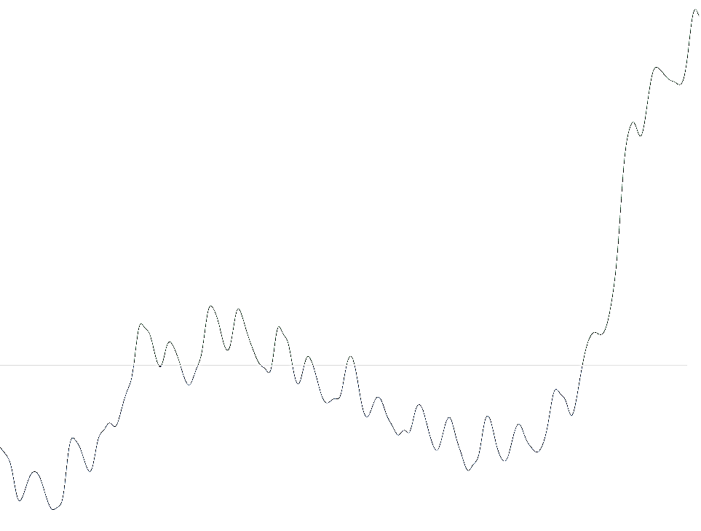
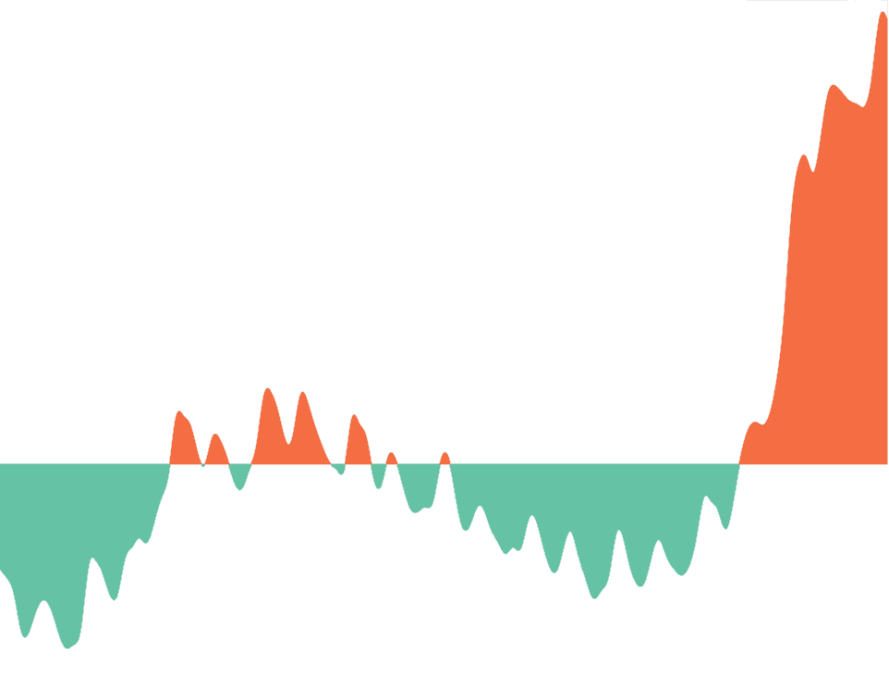

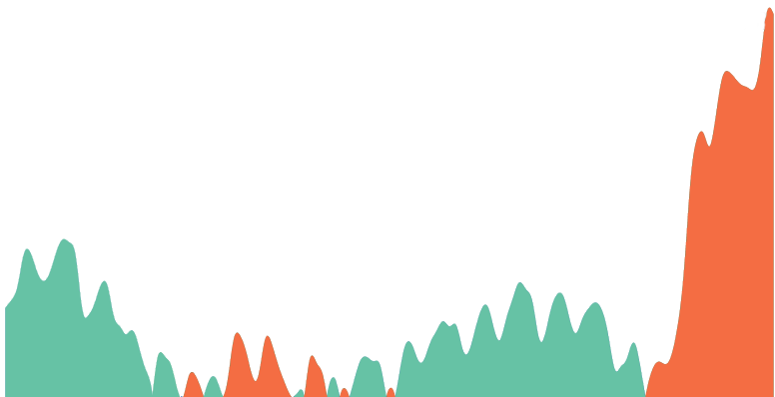

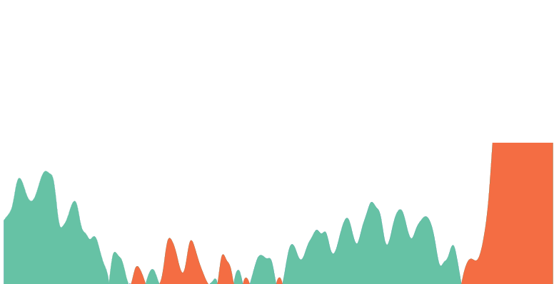
Line Chart
Area Chart
Mirrored Area Chart
Fill area between line and zero
Flip negative values
Cut in half and overlay two bands
Notes:
Sizing the Horizon: The Effects of Chart Size and Layering on the Graphical Perception of Time Series Visualizations, 2009, Berkeley Visualization Lab

Slide 10
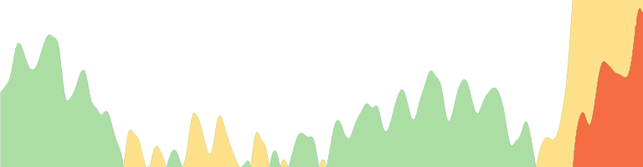


Horizon Chart

Slide 11
Cubism
Cubism.js is a D3 plugin. It uses horizon charts for visualizing time series.
Area Chart
Combine position and color
to reduce vertical space
Horizon Chart
Scalable
Effective
Flexible
Notes:
Scalable: Cubism fetches time series data incrementally: after the initial display, Cubism reduces server load by polling only the most recent values. Cubism renders incrementally, too, using Canvas to shift charts one pixel to the left.
Effective: Because all data shares a common x-axis, it’s easier to spot coincident anomalies.
Flexible: Cubism is data-source agnostic. It has built-in support for Graphite and Cube, and can be readily extended to fetch data from other sources.

Slide 12
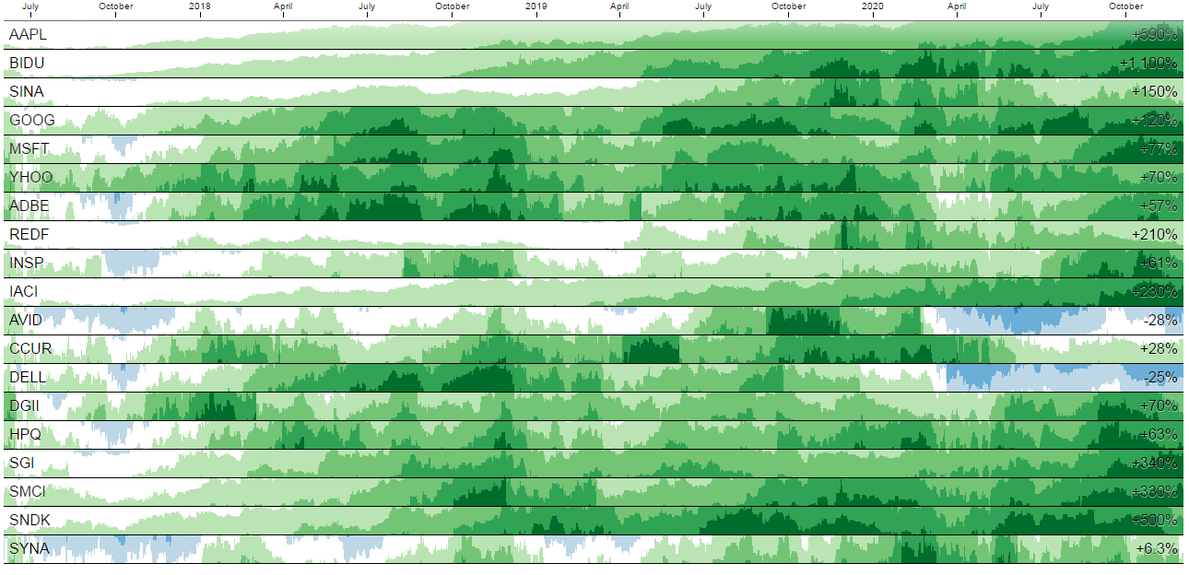
Cubism Application
Change of 19 Technology Stocks^{[1]}
Notes:
[1] Mike Bostock, Square, Inc.
[2] http://tppstats.herokuapp.com/?step=1e3

Slide 13


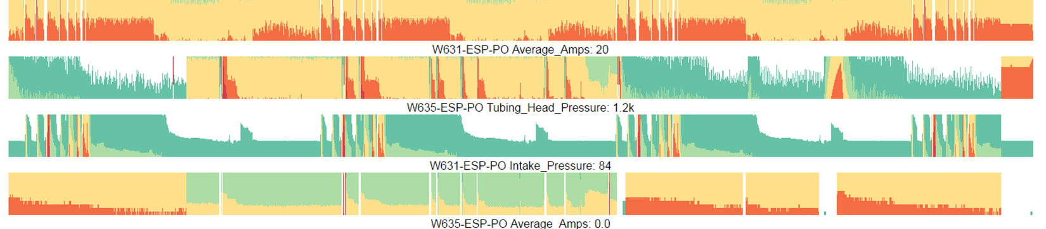

Architecture
Query
Data

Slide 14
Functional Flowchart
Cubism dashboard
Frontend
Checkbox list
Cubism charts
Backend
InfluxDB filter
InfluxDB connection
InfluxDB query

Slide 15
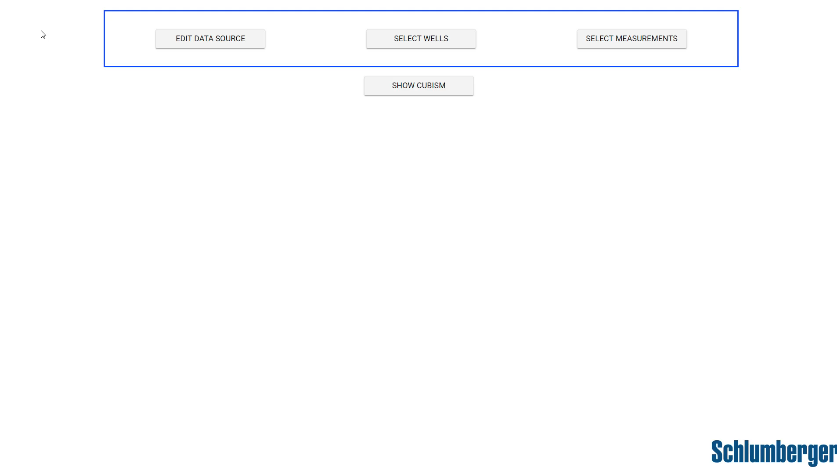
Demo

Slide 16
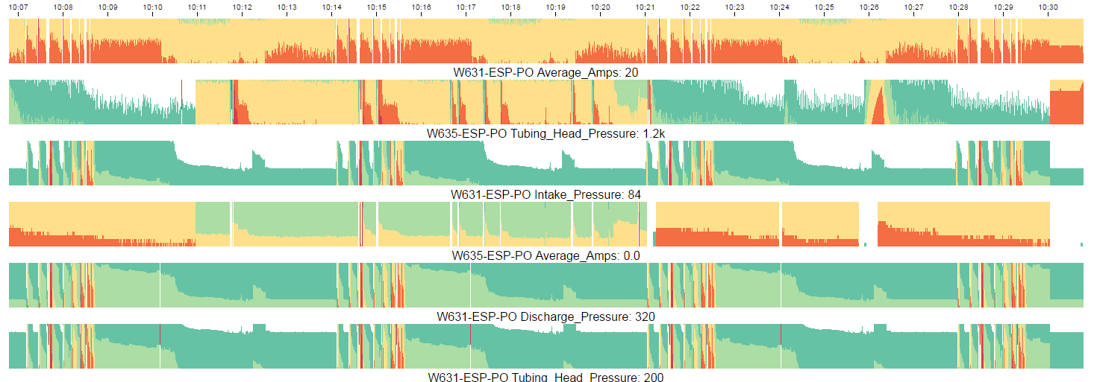
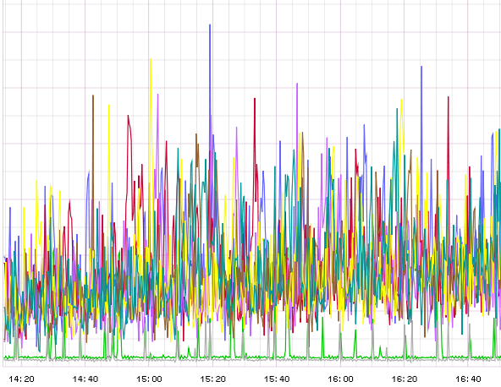
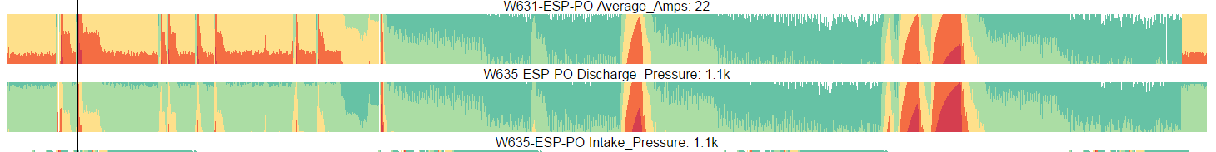
Usability
Stacked cubism charts → More data presented together
Colors represent different range of values
→ Detect abnormal activities or crisis quickly and easily
→ Spot similarities between two measurements
Notes:
Red means the value is big, while green is small.
3.39s 260208datapoints
Cubism fetches time series data incrementally: after the initial display, Cubism reduces server load by polling only the most recent values. Cubism renders incrementally, too, using Canvas to shift charts one pixel to the left.

Slide 17
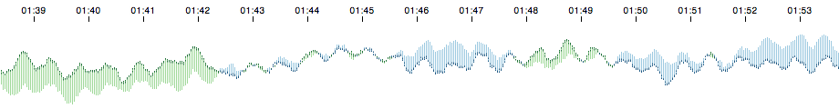
Future Directions
QA test and feedback from surveillance engineers
More data manipulation function implementation
Website Launch
Cubism Comparison Chart
Notes:
such as thresholding and Comparison Charts
Database
Feedbacks
QA☹

Slide 18
What I’ve Learned
Technical skills
Data visualization
Soft skills
Teamwork and collaboration
Web development
Professionalism
Networking
Presentation

Slide 19
Acknowledgements
Thank you to Andrea Pound, Boris Kudryashov, Qing Cao, Andreas Sudihardjo, Felipe Klein, Vincent Rondot, Manu Srinivasa and Liuliu Zheng.
Thank you to the HR team.
Thank you to all the interns.
Notes:
Add what I learned

Slide 20
High-Volume Real-Time Data Visualization
Patrick Cao
Software Engineering Intern
August 25, 2016
Notes:
position

Slide 21
D3.js : Data-Driven Documents
JavaScript library
Interactive data visualizations
Built on top of common web standards: HTML, CSS, DOM, SVG.
Advantages:
Works seamlessly with existing web technologies
Thousands of visualization examples
Vibrant open-source community
Notes:
The JavaScript library D3.js is arguably the most influential tool for creating interactive data visualziations. D3 has been forked over 9,000 times on Github, meaning that other developers are also constantly extending D3.
Perhaps the most important part of D3’s success is the position and approach it takes. It is not a graphics library, nor is it a data processing library. It doesn’t have pre-built charts that limit creativity. Instead, it has tools that make the connection between data and graphics easy. It sits right between the two, the perfect place for a library meant for data visualization.

Slide 22
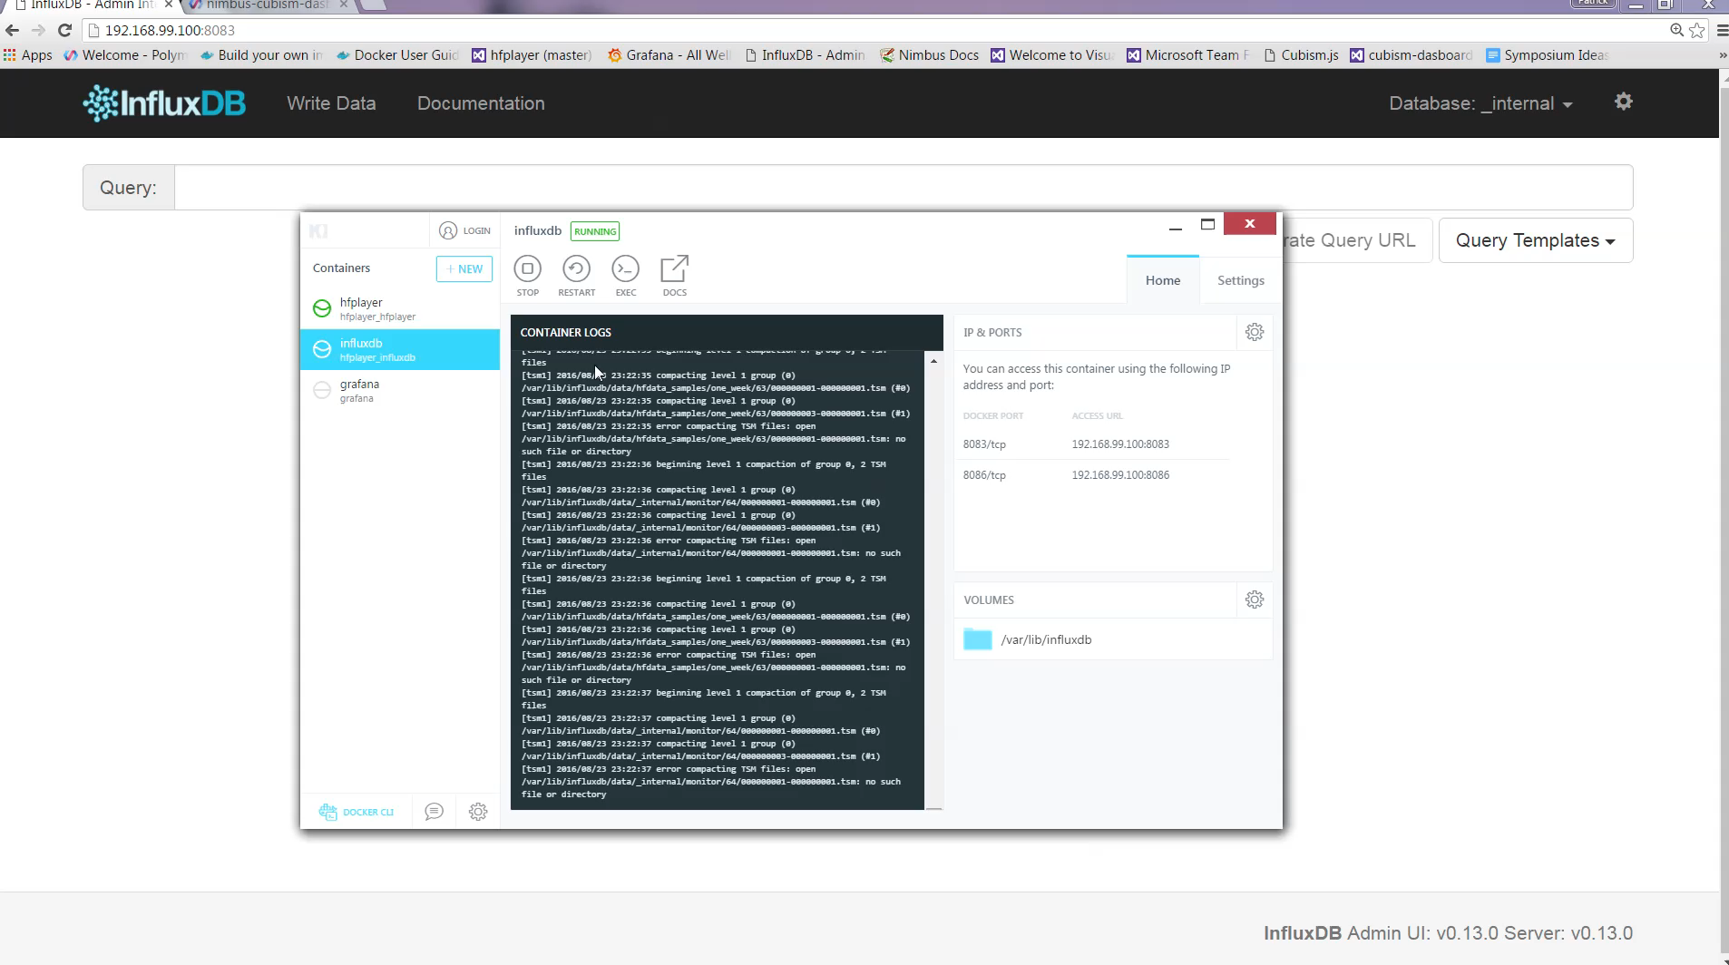
Demo

Slide 23
Technology

Slide 24
Polymer: Not A Framework
Google Polymer is a high-level sugar libraries that build upon the W3 Web Components.
Polymer library allows programmers to make the most of Web Components for extending HTML and componentizing web apps.
Web Component
Custom Elements
HTML Imports
Templates
Shadow DOM

Slide 25
Polymer: Not A Framework
Angular
Framework for building web apps.
Angular directives are to build custom elements without the use of Web Components APIs.
Polymer
Library for creating Web Components.
Polymer and Web Components are the standards-based way to create Custom Elements.
Notes:
Polymer uses a declarative syntax (another element!) to create custom elements. Angular and Polymer will remain separate projects with their own goals. That said, Angular has announced they’ll eventually move to use the Web Components APIs in their underlying architecture.
For Angular 2.0, Web Components will work seamlessly within Angular apps and directives, and components written in Angular will export to Web Components to be used by Polymer or other libraries.

Slide 26
Polyfills
What’s in the future for Polymer
Some features used by Polymer are not yet supported natively in all browers, since Polymer is designed to leverage features baked into the web platform itself for building components.
For broad web components support, Polymer uses the polyfills from webcomponents.org, which can provide the feature support Polymer requires.
With polyfills, Polymer works in Chrome, Firefox IE 11+/Edge, Safari 7+, Chrome (Android) and Safari (iOS 7.1).
Once browser support has improved, polyfills can be removed.
Notes:
Hide this one

Slide 27
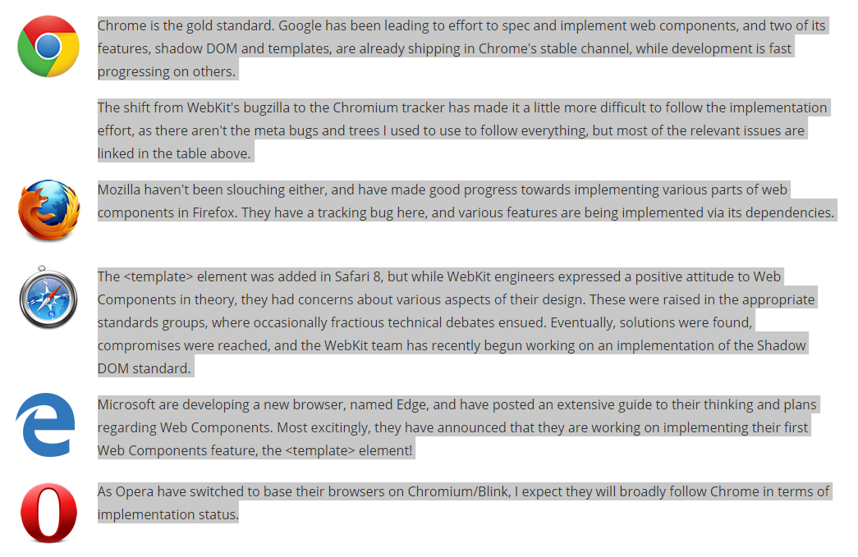
Browser Support of Web Components
[1]
Notes:
[1] http://jonrimmer.github.io/are-we-componentized-yet/

Slide 28
Challenges
Lack of documentation and guidance for Polymer
Implement Cubism with Polymer
Notes:
It also takes a little while to get accustomed to the Polymer way of doing things.

Slide 29
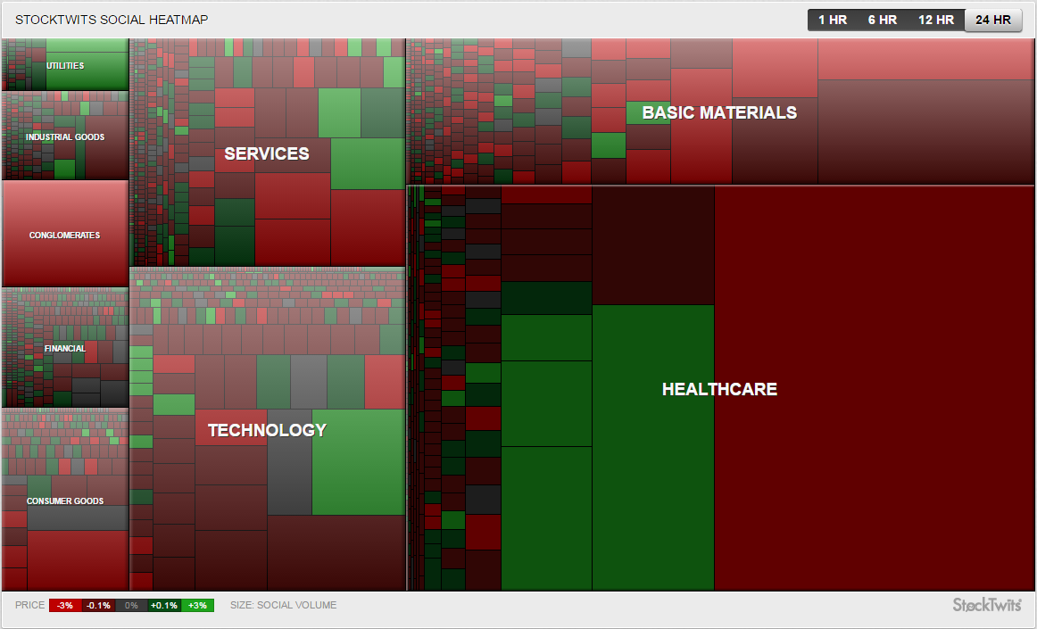
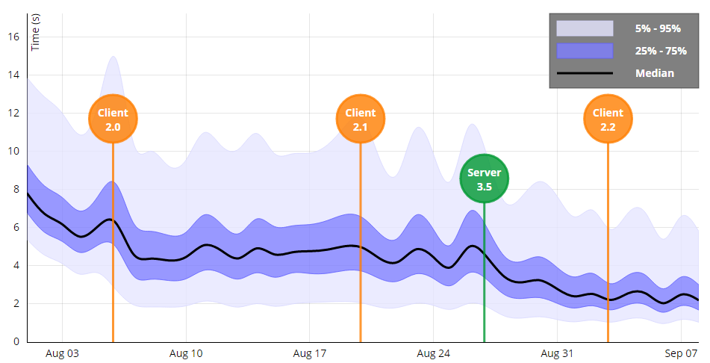
Visualization Candidates
Area Chart: Loading Time Across Releases of A Hypothetical Web Application ^{[4]}
Heatmap: StockTwits Social Heatmap ^{[2]}
Notes:
[1] http://www.visualcinnamon.com/2014/12/using-data-storytelling-with-chord.html
[2] StockTwits
[3] http://bl.ocks.org/dk8996/5538271
[4] http://bl.ocks.org/rkirsling/33a9e350516da54a5d4f

Slide 30
Functional Flowchart
Backend
Frontend
InfluxDB connection
Cubism dashboard
InfluxDB filter
Checkbox list
Cubism charts
InfluxDB query

Slide 31
Cubism
var context = cubism.context()
.step(1e3)
.size(1440);
cubism.context – Keep track of the metric resolution and the number of metric values to fetch and display. Contexts are the root object of any Cubism dashboard.
step – The metric resolution in milliseconds.
size – The number of values.
serverDelay – The amount of time the context waits for the server to compute or collect metrics.
clientDelay – The amount of additional time the context waits to fetch metrics from the server

Slide 32
Cubism
context.metric(request)
context.metric – returns a new metric using the specified request function. This method can be used to define a new data source. Cubism has built-in datasource types for Graphite and Cube.
The request function will be invoked with the start time (a Date), the stop time (another Date), the step interval (a number in milliseconds) and the callback function for when results are available.
metric.add / subtract / multiply / divide / shift() – Metrics are composable.
context.horizon / axis / rule() – Create a new horizon chart / axis / rule.
context.comparison() – Create a comparison chart.

Slide 33
Cubism
<div id=“cubism”>
d3.select(#cubism).call(function(div){
div.selectAll(".horizon")
.data([formatedData])
.enter().append("div")
.attr("class","comparison")
.call(context.horizon()
.height(60).title(…)
.colors(["#08519c", "#*82bd", "#6baed6", "#fee6ce", "#fdae6b", "#e6550d" ])
);});

Slide 34
Problems
Charts not in order
A new way for Cubism to fetch data
Doesn’t support IE

